Slide 1
Yankee Candle
A Day with Yankee
A Softer Evening Starts Here
Insert Video Here: Kemi – 'A Day That Never Stops'

Slide 2
THE CANDLE SCENTRE BRIEF
DIGITAL PROMOTIONAL BRIEF 2
The Candle Scentre launched their Yankee Candle business in 2007 and have been enjoying serving their loyal customers new and old. They have achieved accreditation by becoming one of Yankee Candle’s Destination Stores. This means they carry a large Yankee Candle range and a wide variety of accessories. They were awarded Star Store in 2015 for great customer service and excellent knowledge of the product.
The Candle Scentre are now looking to create a social media profile on your recommended platform where they can promote their products and engage with their target audience of adult women aged 25–44. They would also like you to produce some digital content for your chosen social media platform.

Slide 3

The Candle Scentre
Digital Promotion Campaign

Slide 4

Aim of the Project
Launch first social media presence
Promote Yankee Candle to women 25–44
Increase brand awareness and engagement
Modernise promotional strategy

Slide 5
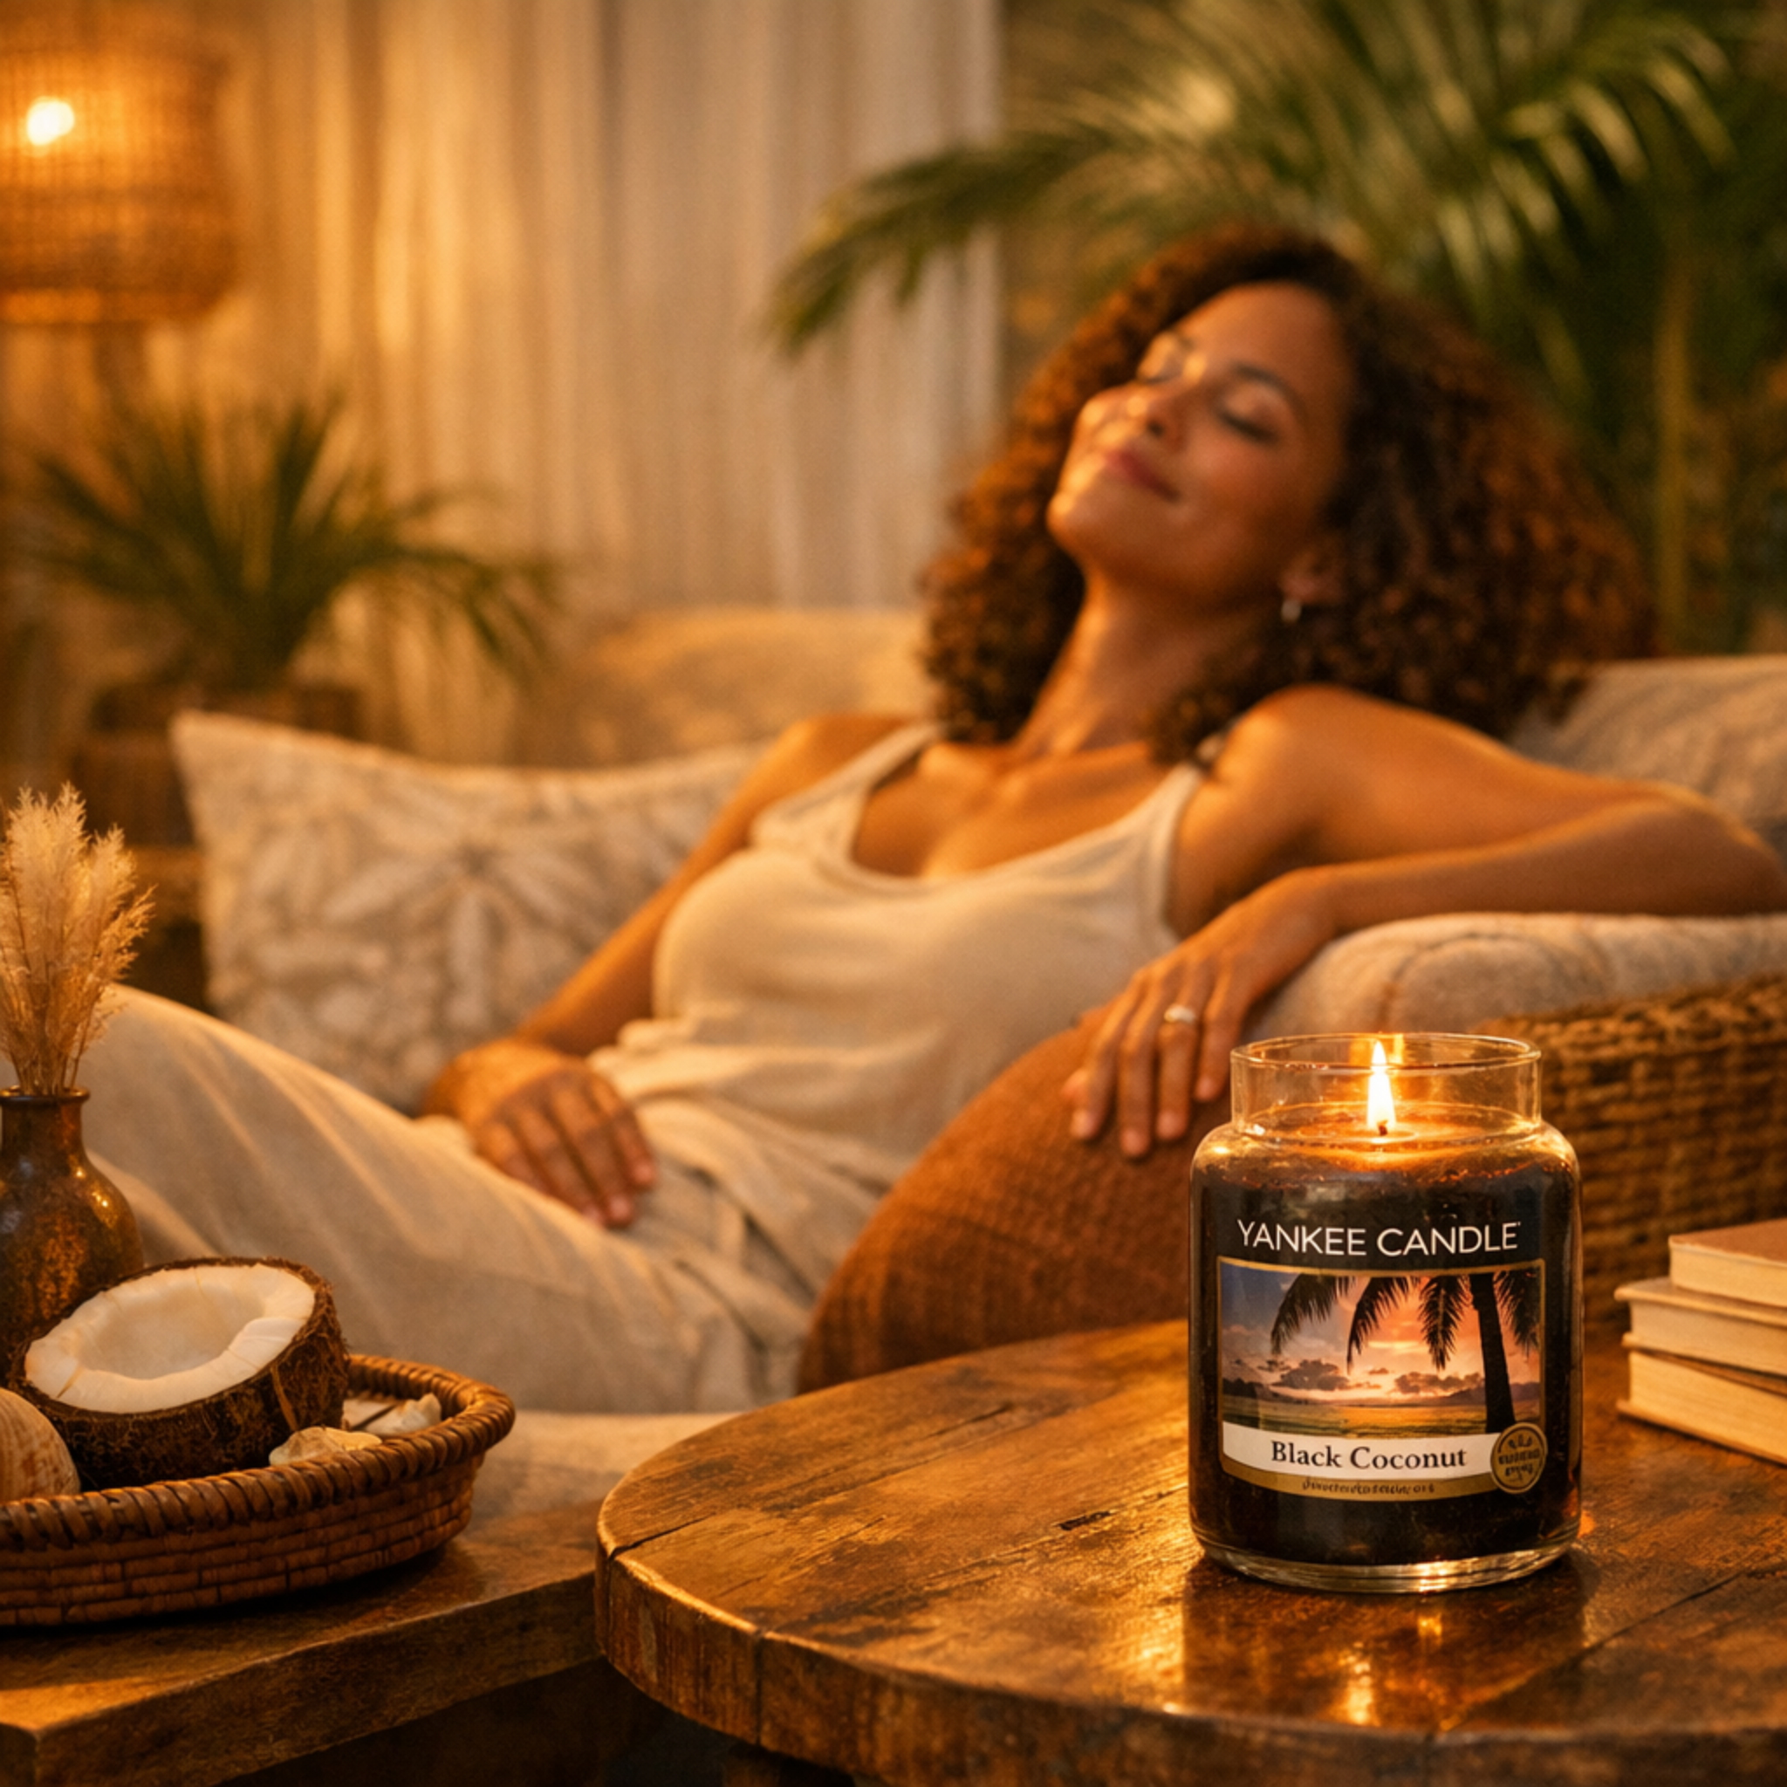
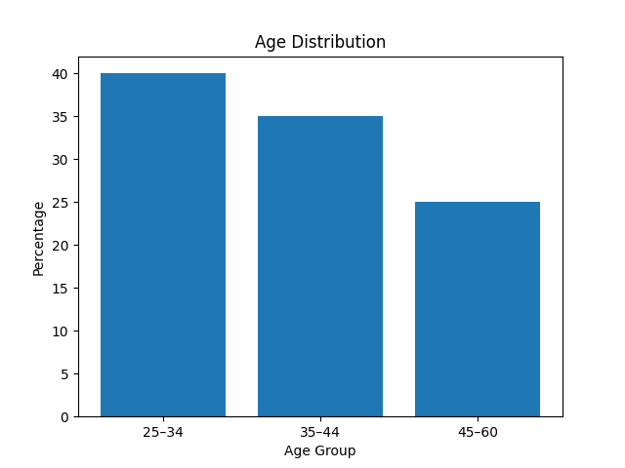
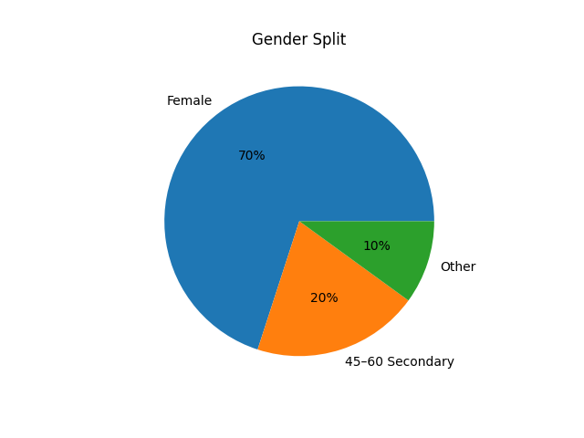
Target Audience Lifestyle
Demographics – Who They Are
Wellness-focused and socially active
Value self-care and relaxation
Use candles for atmosphere and ritual
Active on Instagram
Audience Profile
Age 25–44 primary (45–60 secondary)
Predominantly female
Urban & suburban UK
Middle income professionals
University educated
Young professionals, couples, mothers

Slide 6
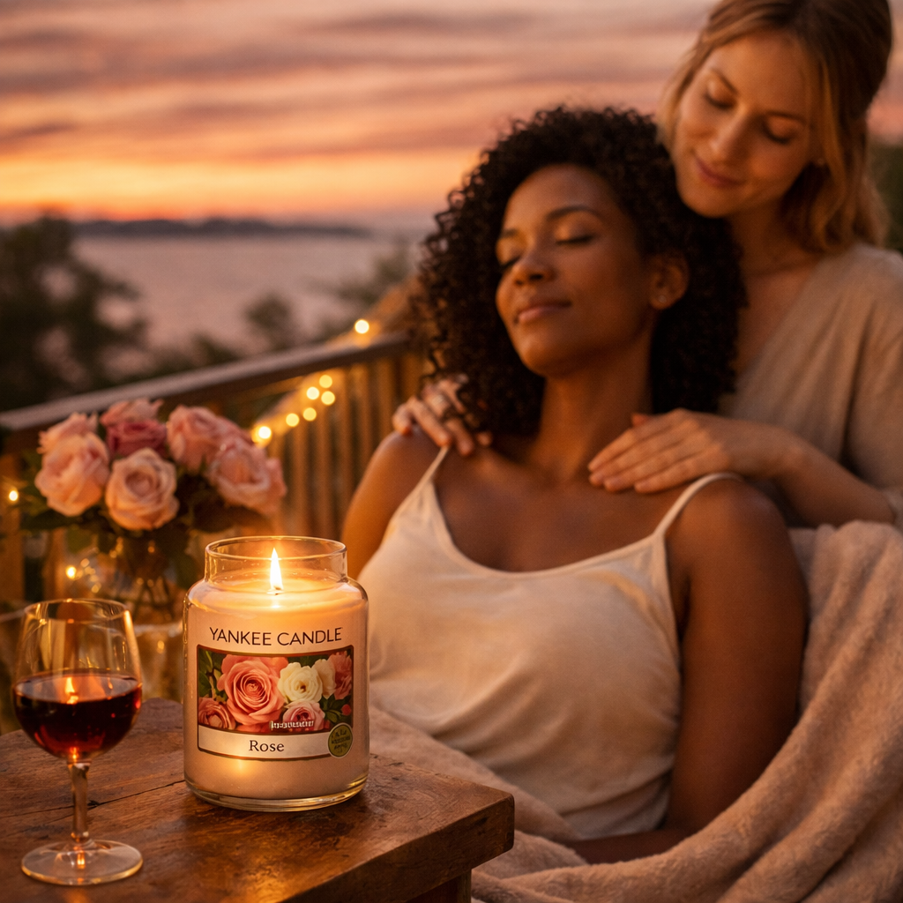
Psychographics – How They Think & Live
Mindset & Behaviour
Value calm & balance
Self-care is essential
Create welcoming homes
Host gatherings & brunch
Emotion-driven buyers
Influenced by Instagram aesthetics

Slide 7

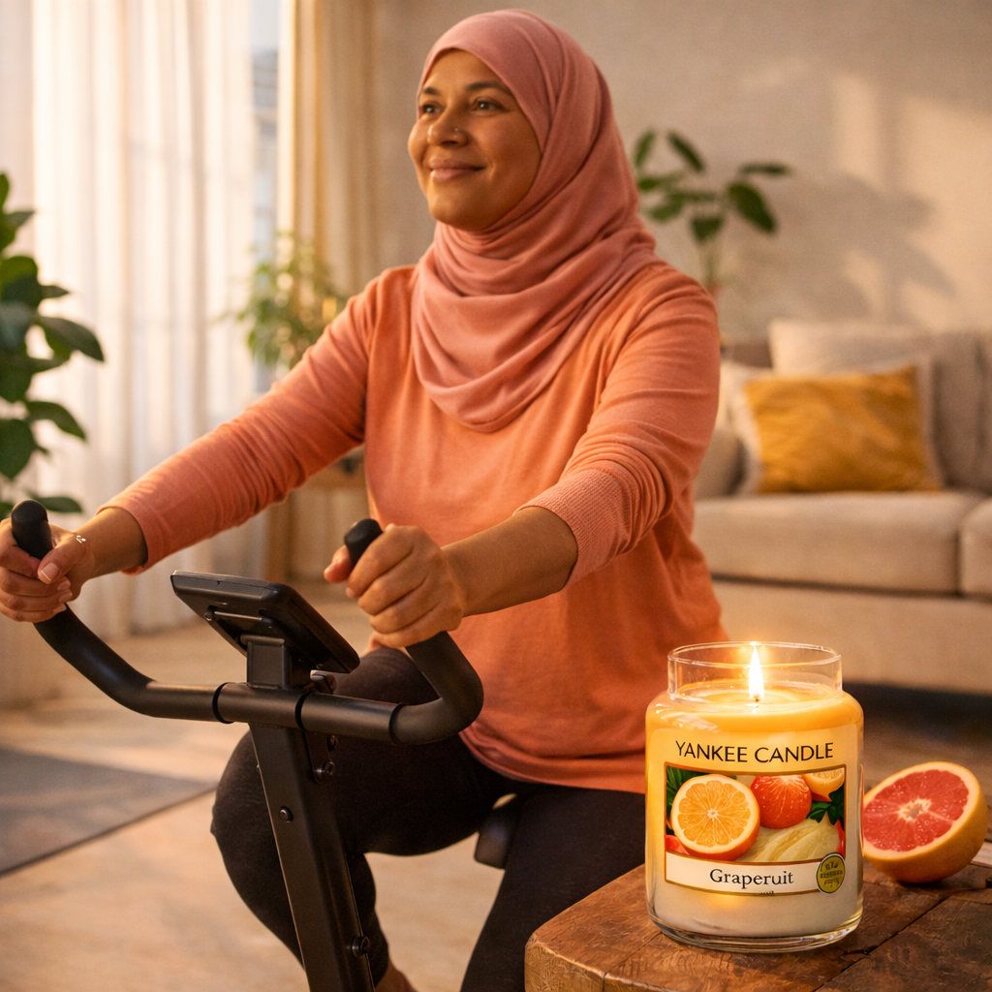
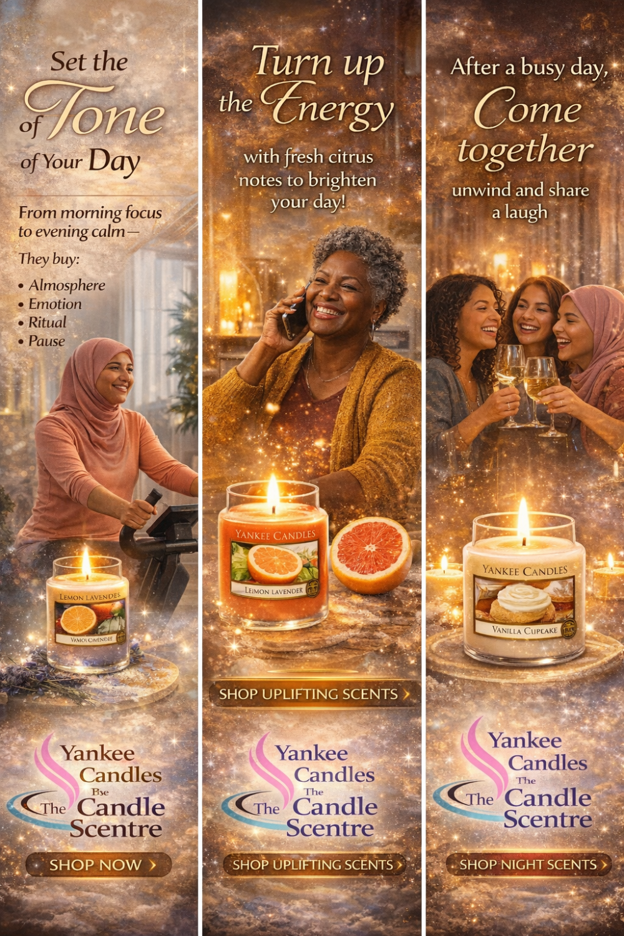
Noel's Ideas

Slide 8
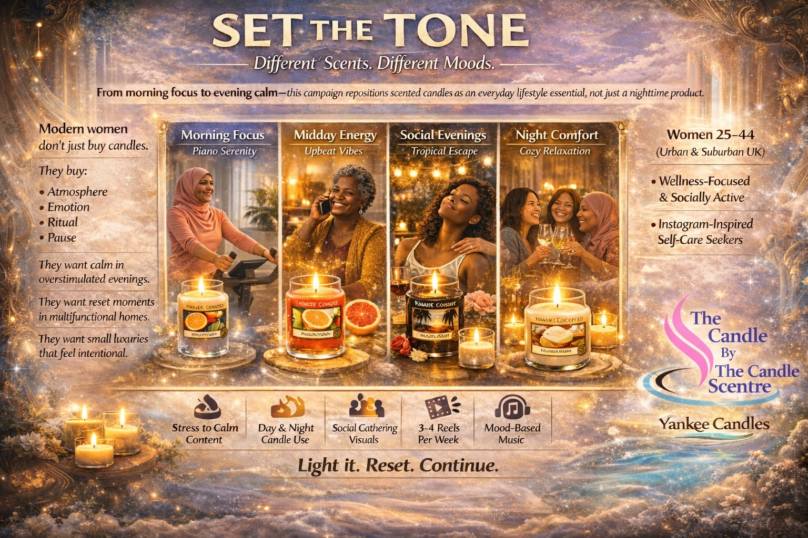
Campaign Concept: Set the Tone
Different scents for different moods
Morning focus to night comfort
Everyday lifestyle positioning
Light it. Reset. Continue.

Slide 9
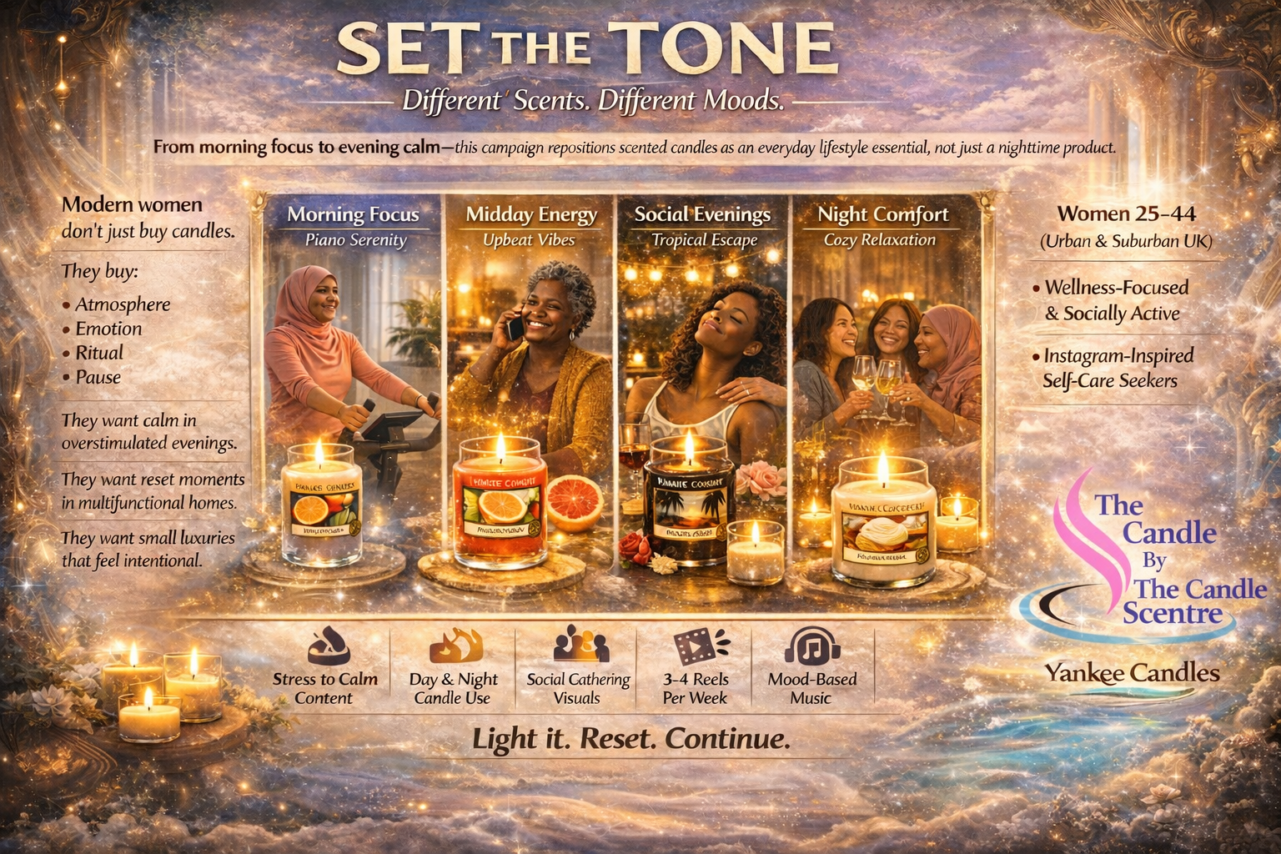
Noel's Final Poster and VIdeo

